Slide 1
Inelastic Neutron Scattering Data Visualization and Analysis Using Mantid
Andrei Savici - ORNL

Slide 2
Why Mantid?
Used at SNS, ISIS, HFIR, NIST
Neutrons, muons, X-rays
Diffraction, Inelastic, SANS, Reflectometry

Slide 3

Why Mantid?
Instrument log files
MantidScript
Command line & Scripting interface
Mantid Framework
RAW data files
API
Algorithms
Workspaces
MantidPlot Graphing and analysis
NEXUS data files
User Defined
User Defined
DAE direct access
Instrument specific UI
Future Instrument specific UI

Slide 4
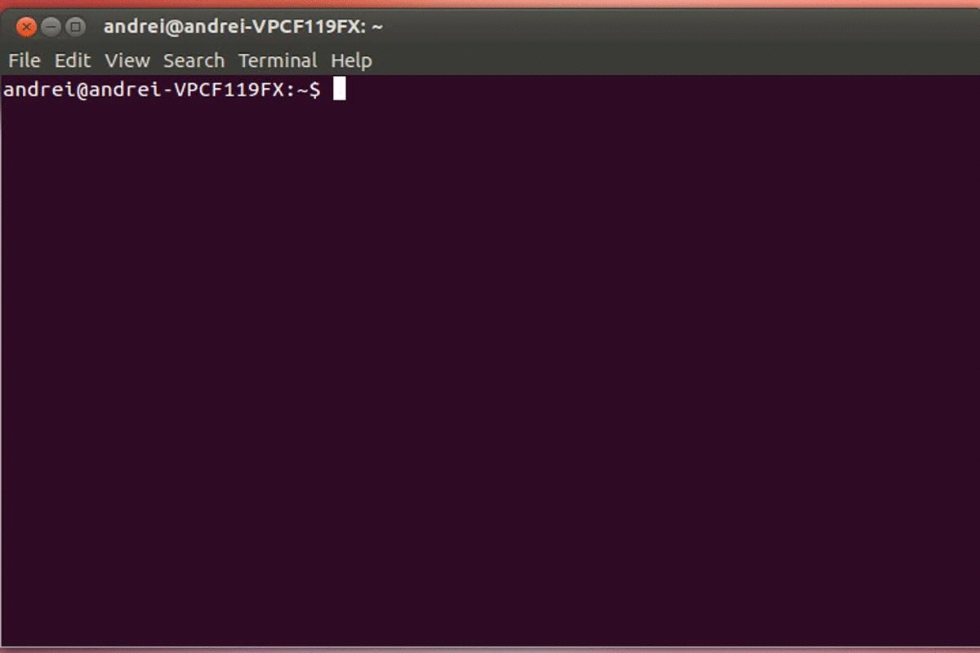
How to interact with Mantid?
Running python without MantidPlot

Slide 5
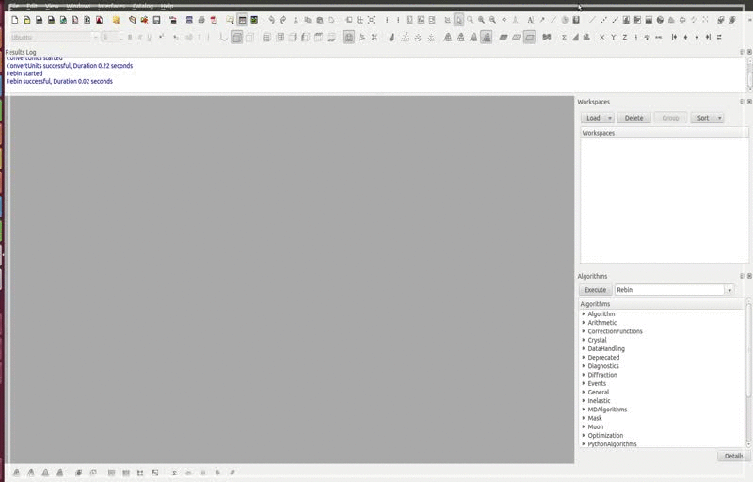
How to interact with Mantid?
Running python without MantidPlot
Technique Specific GUIs

Slide 6
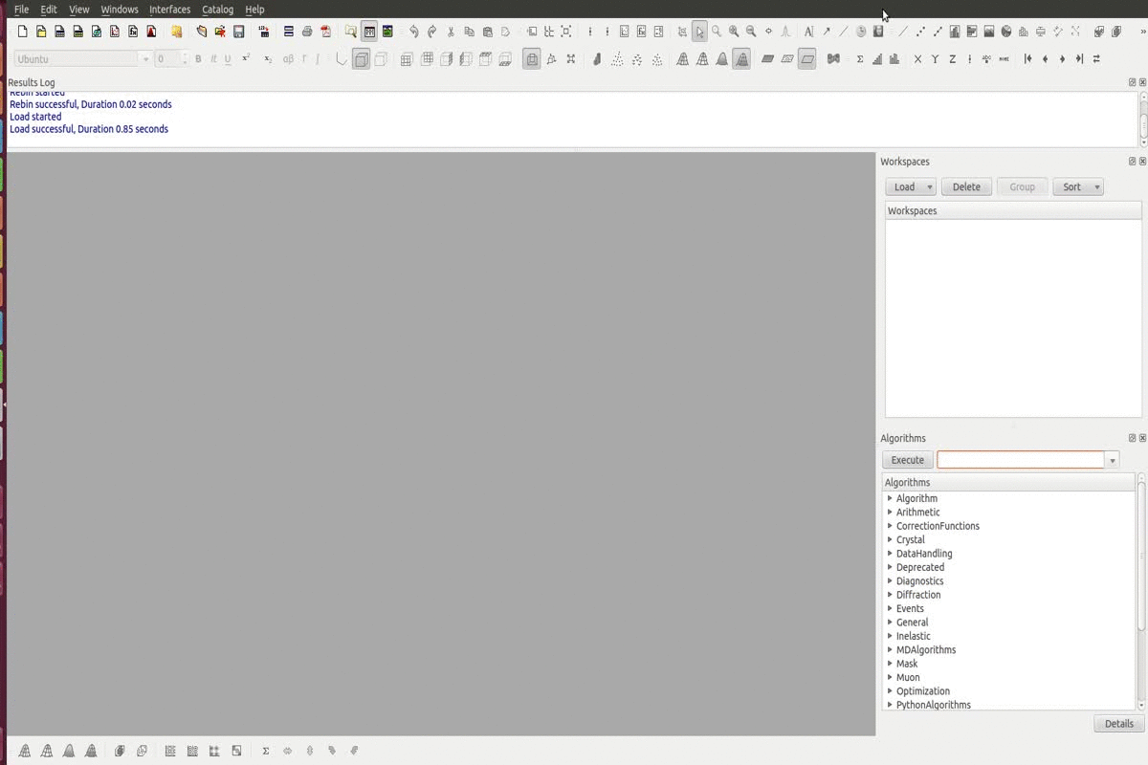
How to interact with Mantid?
Running python without MantidPlot
Technique Specific GUIs
Click on Load/Algorithms

Slide 7
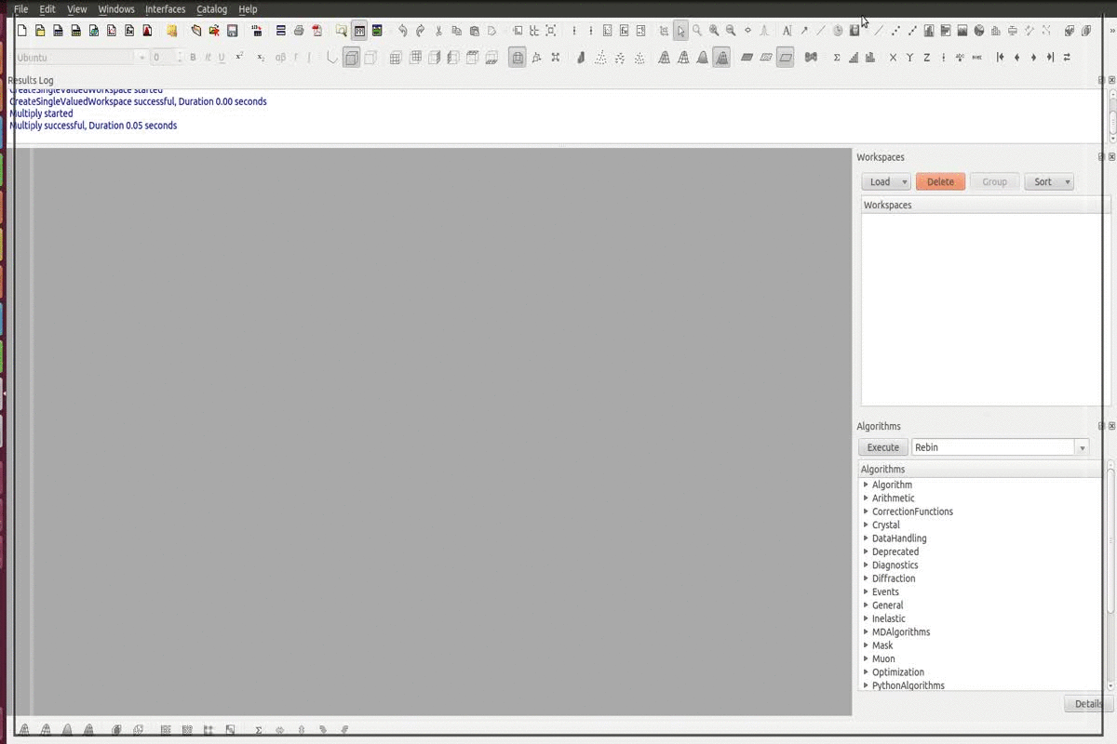
How to interact with Mantid?
Running python without MantidPlot
Technique Specific GUIs
Click on Load/Algorithms
Script window/ console

Slide 8
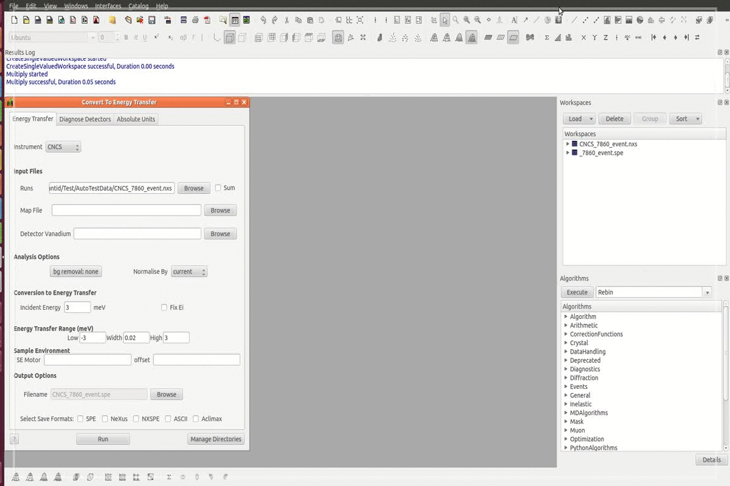
How to interact with Mantid?
Running python without MantidPlot
Technique Specific GUIs
Click on Load/Algorithms
Script window/ console
Generate History

Slide 9
Algorithms for inelastic neutron scattering
Loading
Arithmetic (+,-,*,/)
Get fixed energy
Convert units
Absorption corrections
k_{i}/k_{f}
Time independent background
Time of flight corrections
Masking
Grouping
Rebinning
Saving

Slide 10
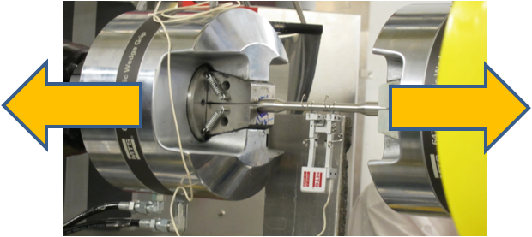
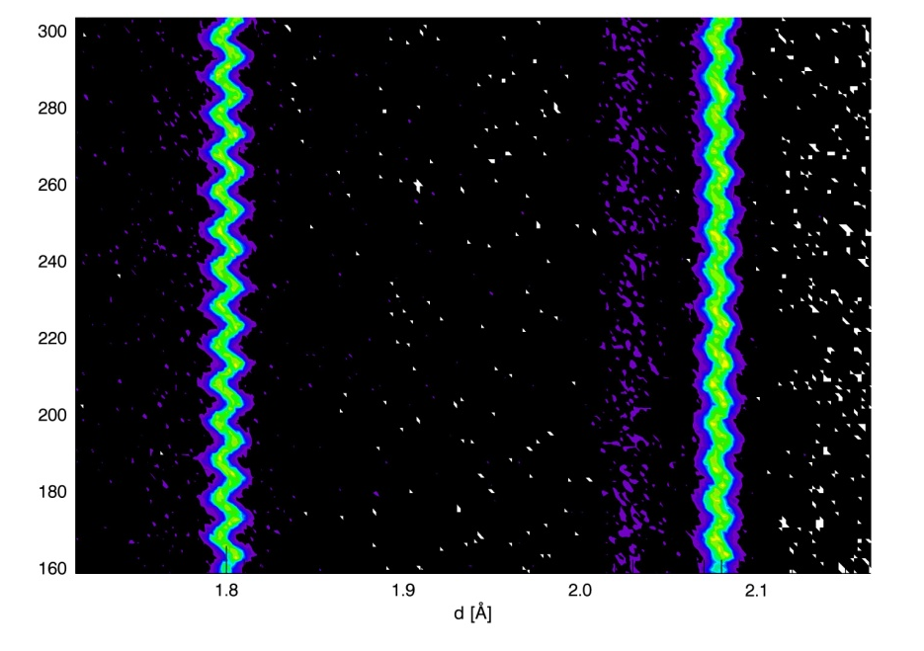
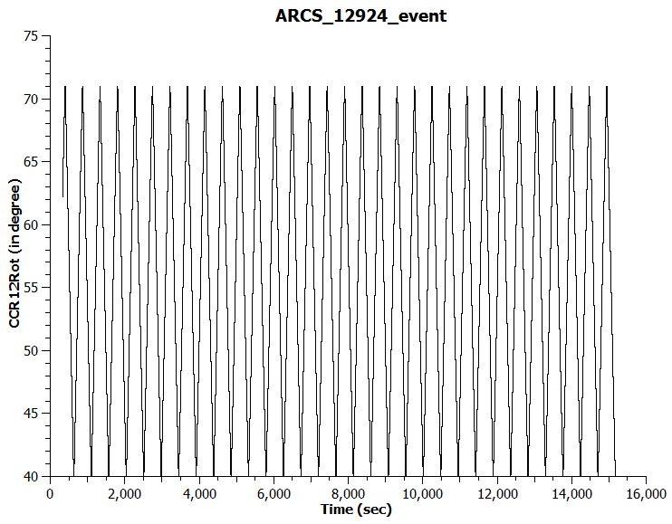
Neutron events
Neutron event = TOF (or other unit)
+ weight
+ pulse time
Environment logs must keep time

Slide 11
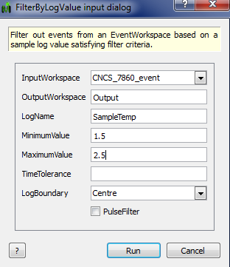
Event filtering
Use cases:
Fix experimental mishaps
Asynchronous parameter scans (continuous angle rotation or changing temperature)
Pump probed experiments (pulsed magnets, strains under vibrations)
Algorithms:
FilterByTime
FilterByLogValue
FilterEvents + GenerateEventsFilter

Slide 12
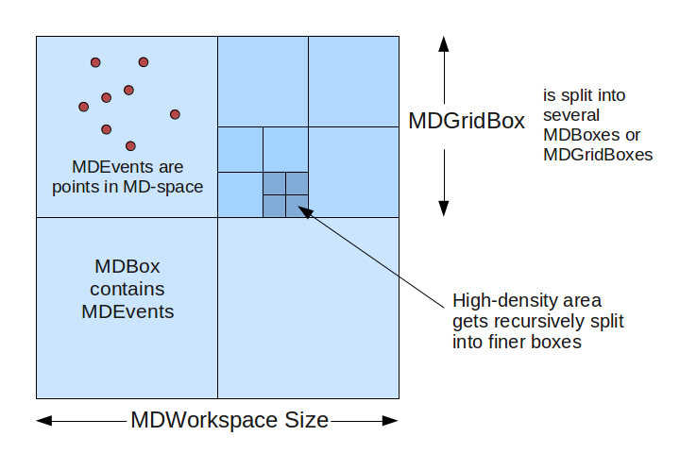
Multi-dimensional workspaces
MDEvent = point (multiple coordinates) + weight + error
+ run info + detector ID
MDHistogram = intensity + error on regular grid

Slide 13
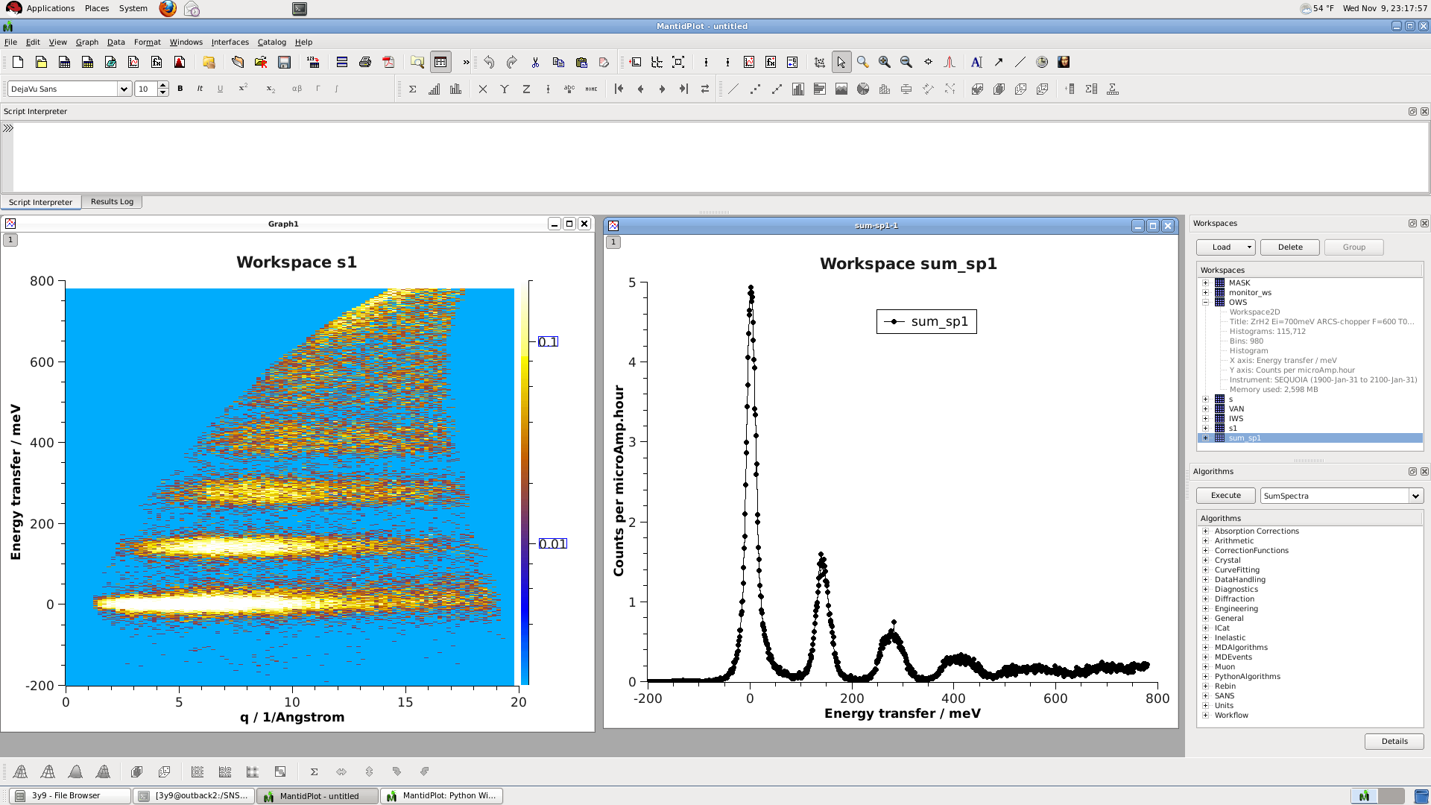
Visualization
1D, 2D plots

Slide 14
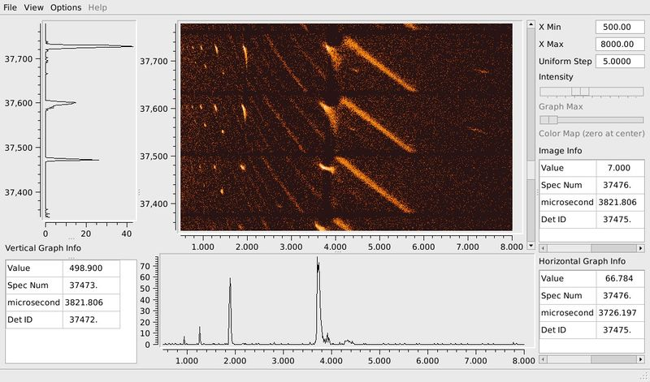
Visualization
ImageViewer

Slide 15
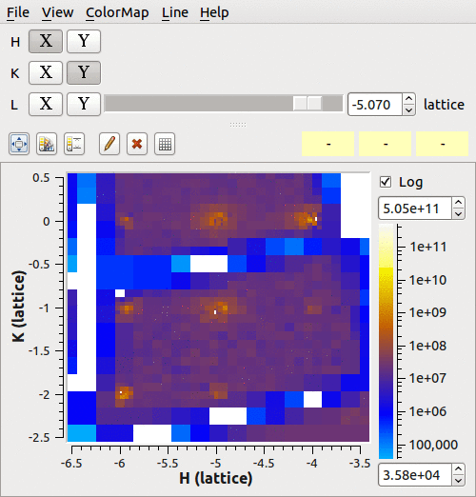
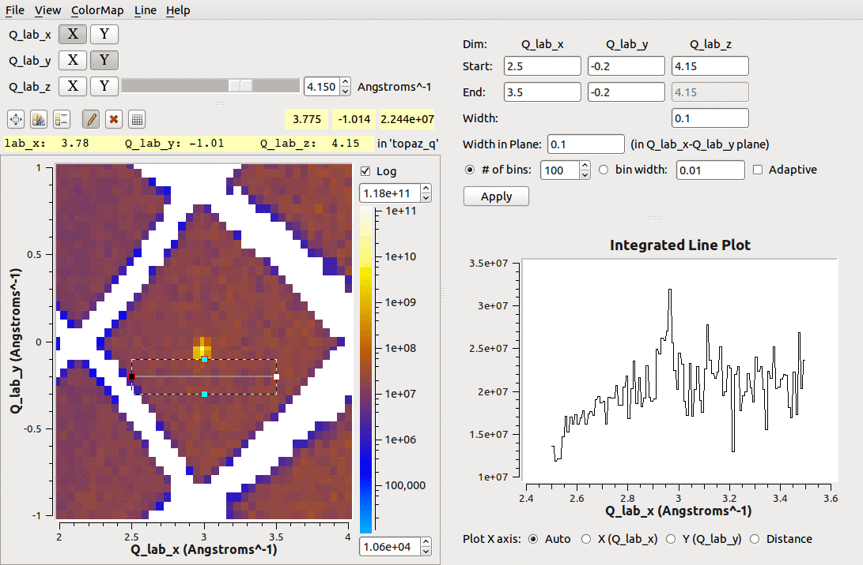
Visualization
SliceViewer/LineViewer

Slide 16
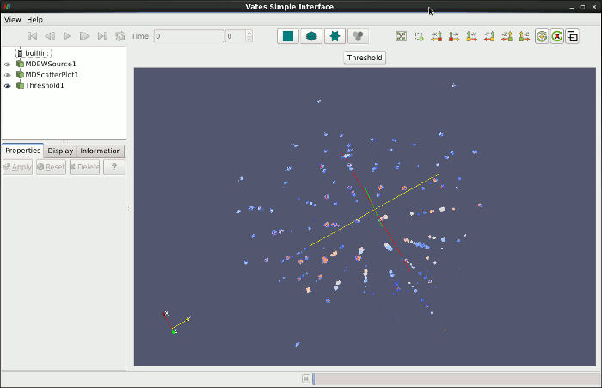
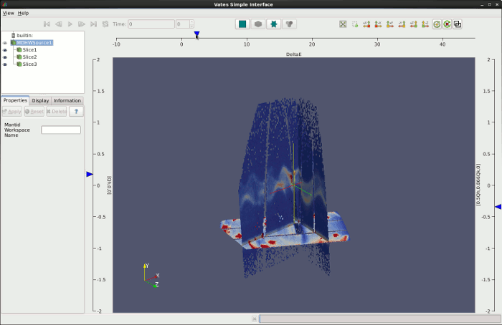
Advanced visualization
Simple VATES interface

Slide 17
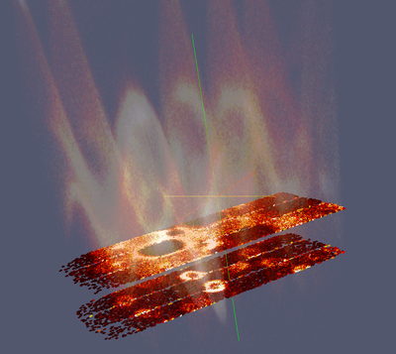
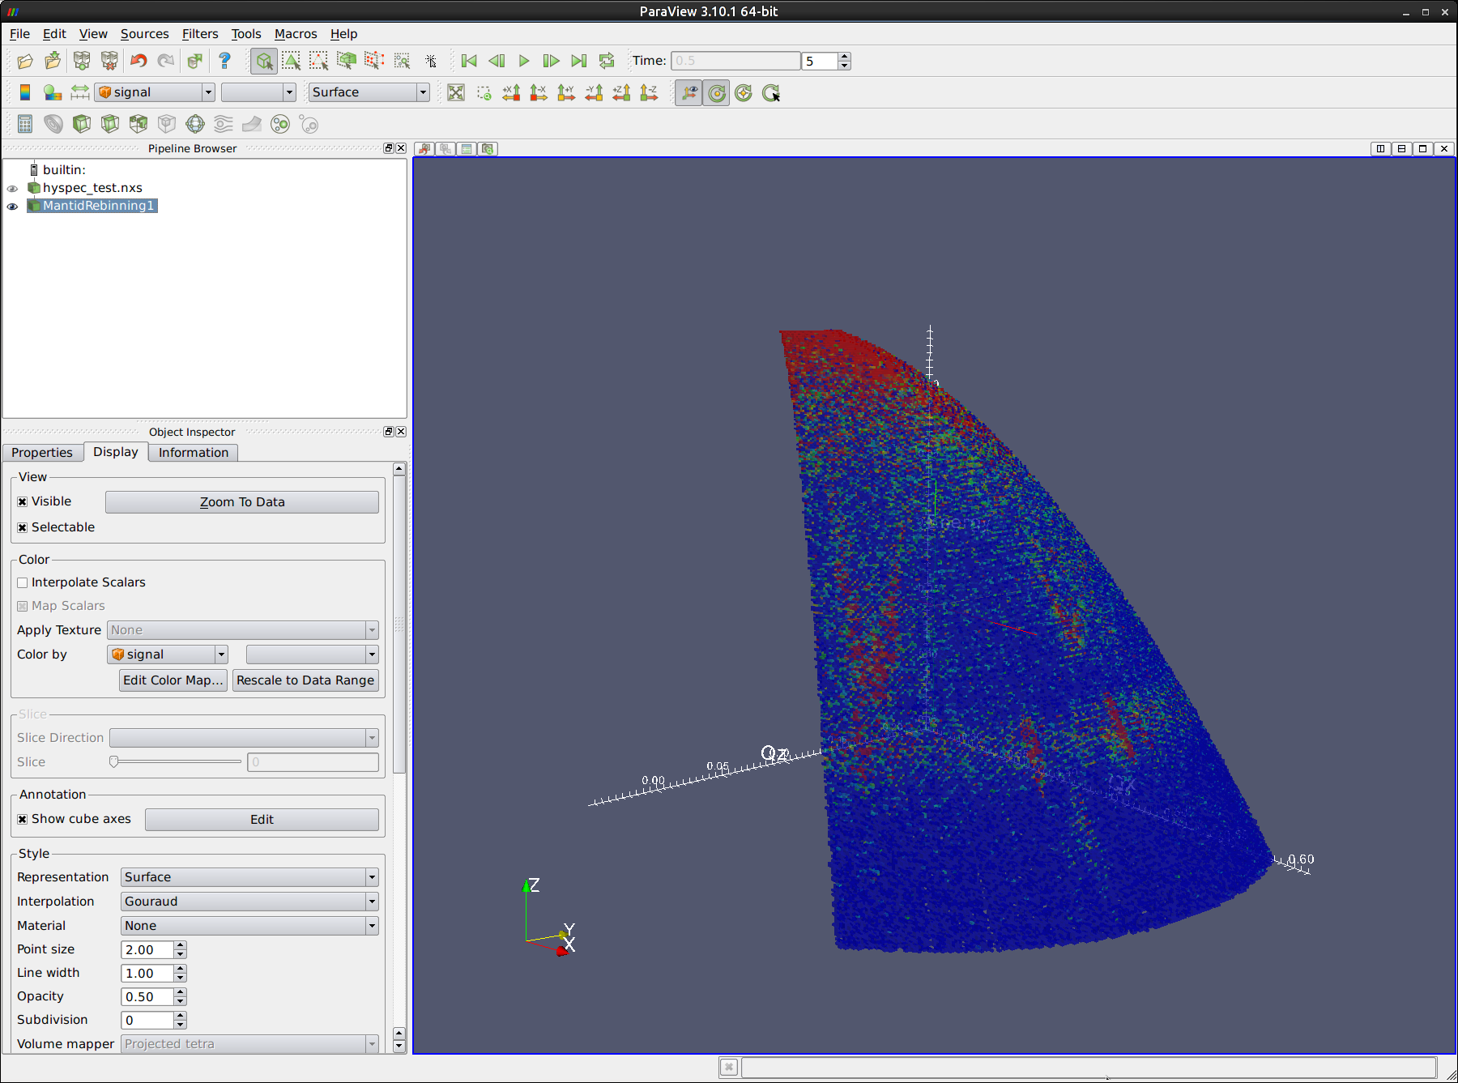
Advanced visualization
Paraview

Slide 18
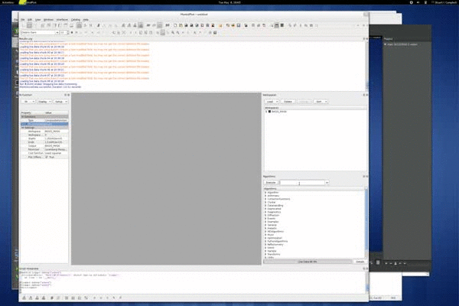
Future plans
Automatic data reduction
Live data reduction
Quantitative analysis, resolution convolved model fitting

Slide 19
Highlights of Mantid
Framework
Event handling

Slide 20




Contributions
Owen Arnold
Alex Buts
Stuart Campbell
Martyn Gigg
Michael Reuter
Janik Zikovsky
Wenduo Zhou
rest of the Mantid development team
www.mantidproject.org

